Slide 1
Programming for Data Science
DSGT Beginner Workshop
02/05/2019
https://tinyurl.com/y72lptlo
Install Anaconda: https://www.anaconda.com/distribution/#download-section

Slide 2
What’s a Program?
A sequence of instructions specifying how to perform a computation.

Slide 3
Parts of a Program
Each program can be broken down into 5 components:
Input - this is your data; obtained from an excel file, CSV file, TSV file, SQL database etc.
Output - inferences from your data through data visualization
Math
Conditional Execution
Repetition

Slide 4
Function
A sequence of statements, combined together based on a problem, that organizes programs into chunks

Slide 5
Math Operators & Assignment

Slide 6
Math Operators
Operator | + Addition | - Subtraction | * Multiplication | ** Exponentiation | % Modulus | / Regular Division | // Floor Division
Example | a + b | a - b | a * b | a ** b | a % b | a / b | a // b
Explanation | Adds b to a | Subtracts b from a | Multiplies a by b | Raises a to the bth power | Gives remainder of a divided by b | Divides a by b | Divides a by b and truncates the decimal

Slide 7
Assignment Operators
Operator | = Assignment | += | -= | *= | **= | %= | /= | //=
Example | c = a | c += a | c -= a | c *= a | c **= a | c %= a | c /= a | c //= a
Explanation | Assigns value of a to c | Increments value of c by a | Decrements the value of c by a | Multiplies c by a and stores the result in c | Raises c to the ath power and stores the result in c | Gives remainder of c divided by a and stores the result in c | Divides c by a and stores the result in c | Divides c by a, truncates the decimal, and stores the result in c

Slide 8
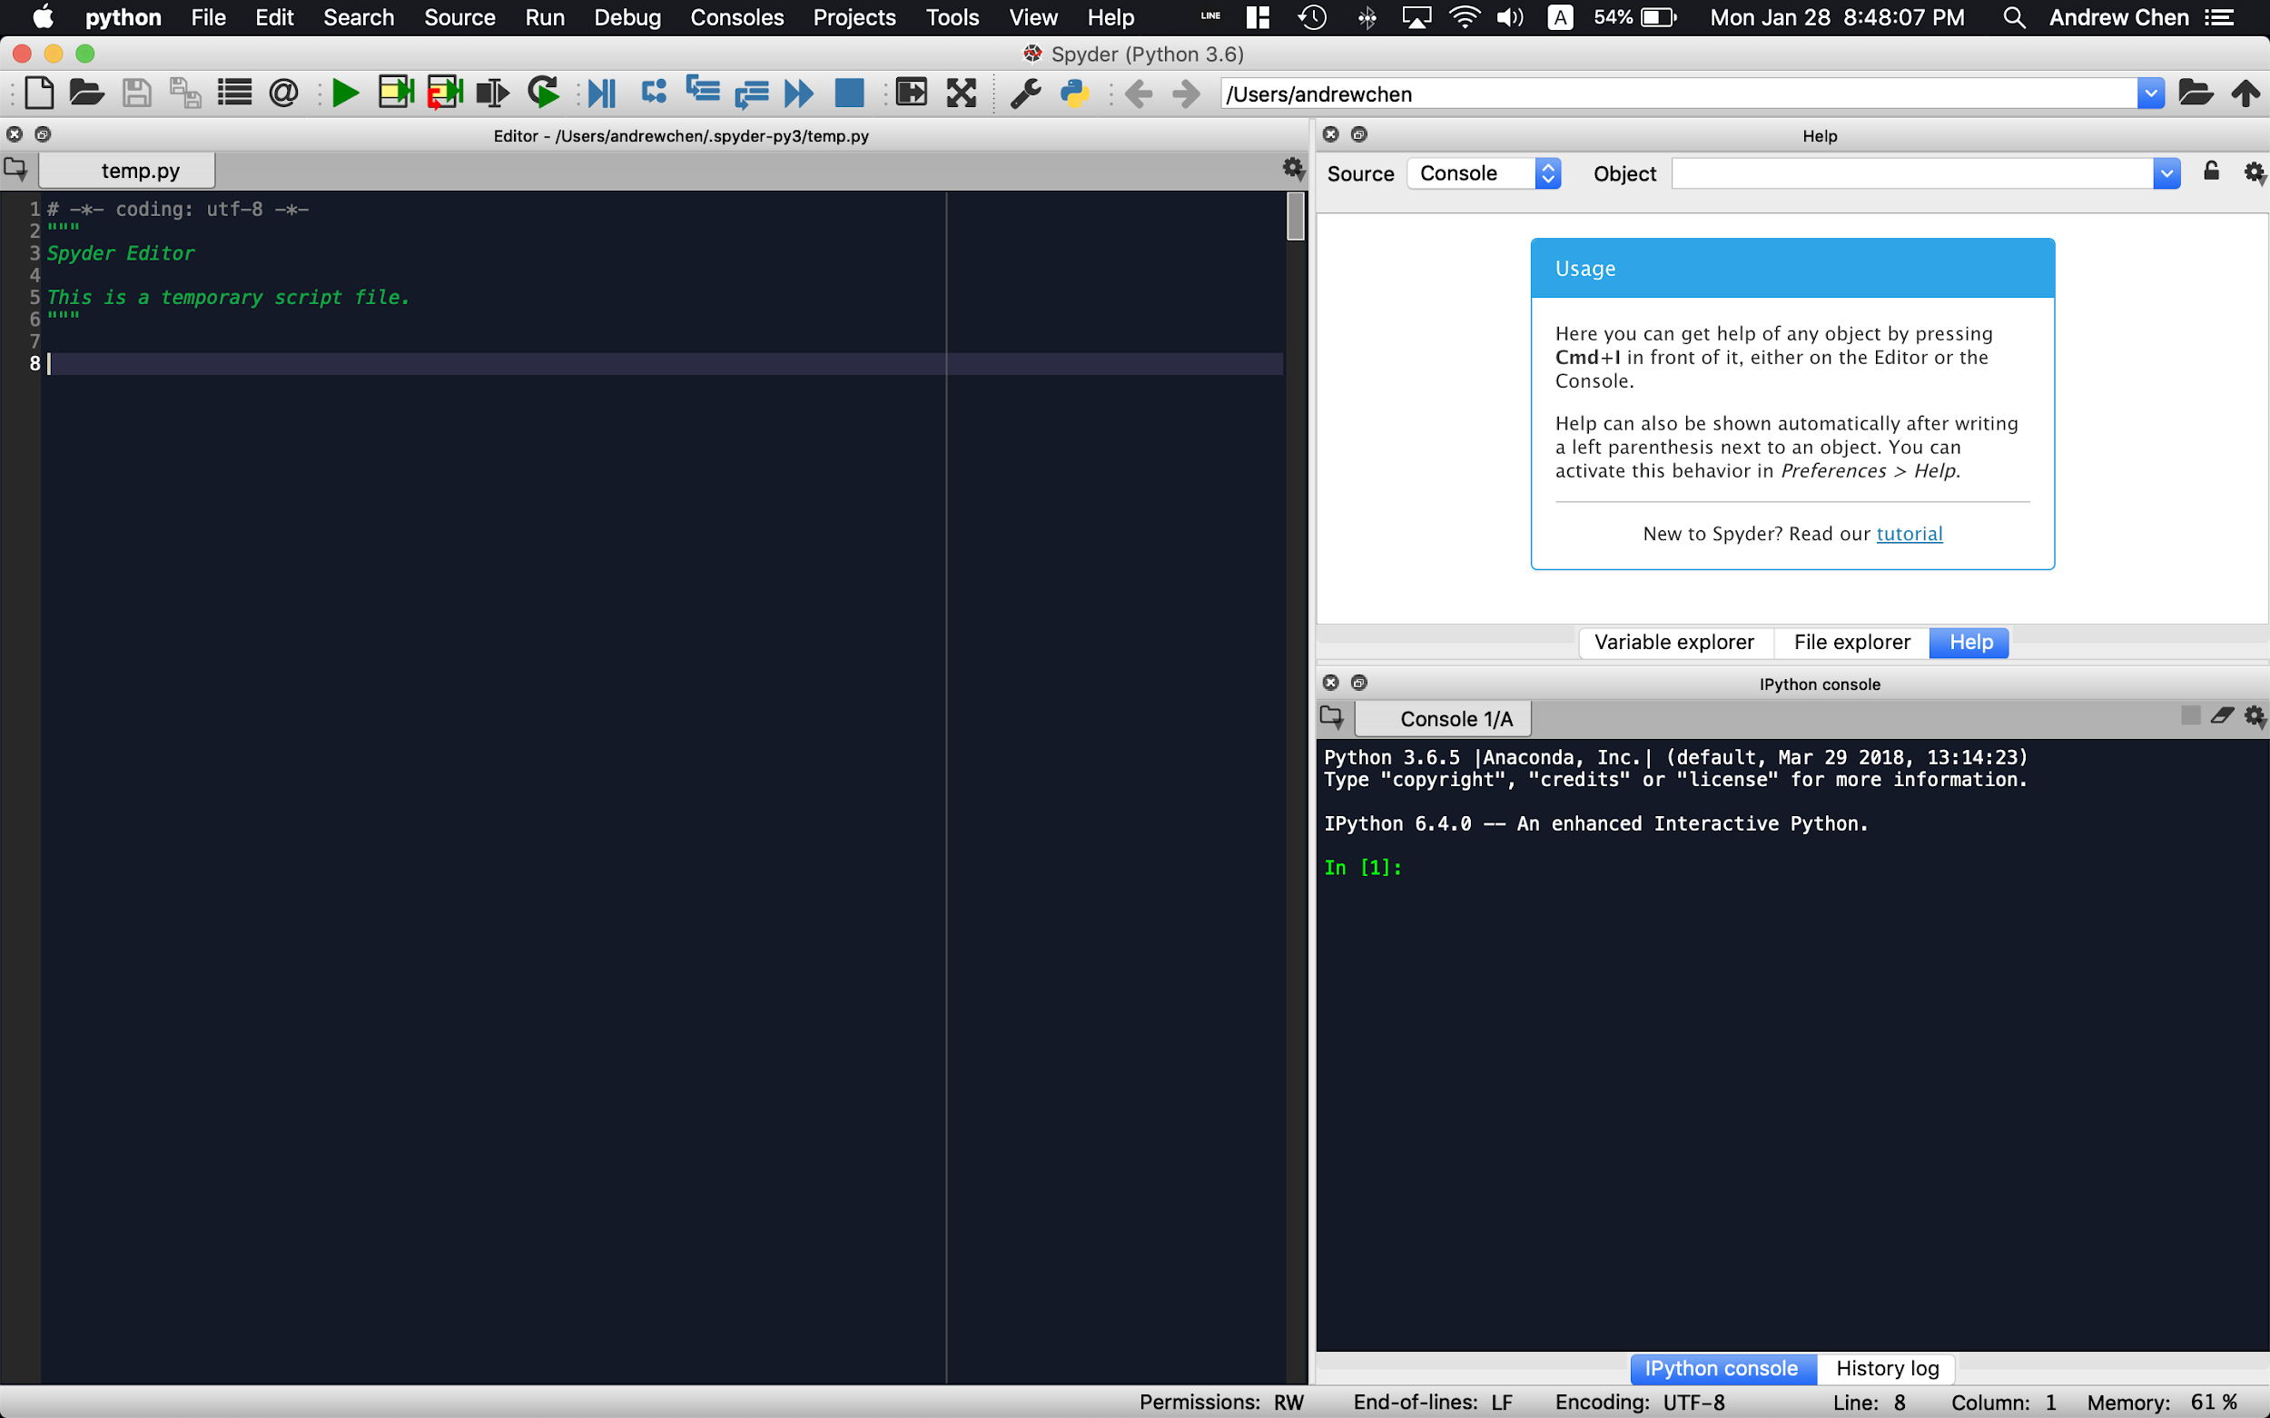
Try it on Spyder!
Start typing here
Ex:
In [1]: aNum = 3
In [2]: bNum = 4
And then try out the different operations yourself!

Slide 9
Conditional Logic

Slide 10
Comparison Operators
Operator | == | != | > | < | >= | <=
Example | a == b | a != b | a > b | a < b | a >= b | a <= b
TRUE if… | a equals to b | a is not equal to b | if a is greater than b | if a is smaller than b | if a is greater than or equal to b | if a is smaller than or equal to b

Slide 11
Membership Operators
Operator | in | not in
Example | a in seq | a not in seq
TRUE if… | a is found in the sequence seq | a is not found in the sequence seq

Slide 12
Identity Operators
Operator | is | is not
Example | a is b | a is not b
TRUE if… | a and b point to the same object | a and b does not point to the same object

Slide 13
Looping

Slide 14
while loop
while expressions:
statement(s)
>>> repeats statement(s) until the boolean value returned by expressions is FALSE
>>> the loop is not entered if the initial boolean value of expressions is FALSE
>>> used commonly when iteration is unknown before execution

Slide 15
for loop
for iterating_var in sequence:
statement(s)
>>> executes statement(s) for each iterating_var in the sequence
>>> used commonly when intended iteration is known

Slide 16
Nested loop
for iterating_var in sequence:
for iterating_var in sequence:
statement(s)
statement(s)
while expressions:
while expressions:
statement(s)
statement(s)
while expressions:
for iterating_var in sequence:
statement(s)
statement(s)
Inner
Loop
Outer Loop

Slide 17
Define Functions & Their Scope
def myFunction():
print (“This is a function.”)
myFunction()

Slide 18
Define Functions & Their Scope (cont’d)
CREATES a new variable x in the scope of myFunction 2() instead of modifying the outer x
def myFunction1():
x = 1
def myFunction2(a):
print (a+x)
myFunction2(2)
myFunction1()
def myFunction1():
x = 1
def myFunction2(a):
x = 4
print (a+x)
print (x)
myFunction2(2)
myFunction1()
Scope of x
Scope of outer x
Uses the outer x
Scope of inner x
Uses the inner x
Prints the outer x

Slide 19
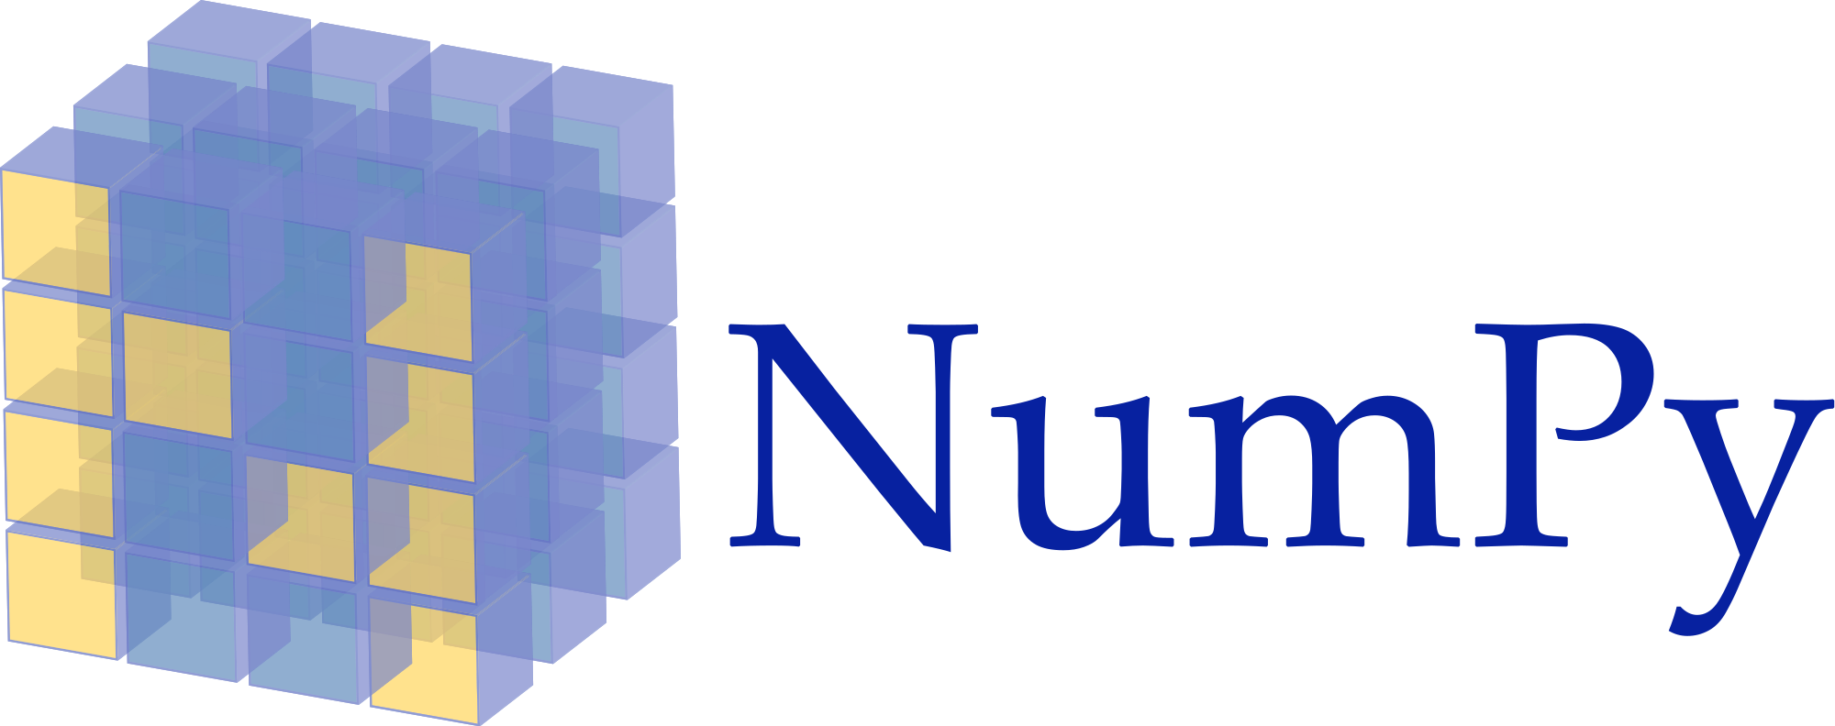
Library: NumPy
Fundamental package for scientific computing
Supports large N-dimensional homogeneous array objects (accessed through non-negative integer index, however)
Provides sophisticated mathematical functions for the arrays and matrices
Also contained some useful linear algebra, Fourier transform, and random number capability

Slide 20

Library: SciPy
Built upon NumPy with more fully-featured versions of the linear algebra modules and numerical algorithms
More likely to find new features in SciPy rather than NumPy

Slide 21

Library: Pandas (Python Data Analysis Library)
Takes data (like a CSV or TSV file, or a SQL database) and creates a Python object with rows and columns called data frame that looks very similar to table in a statistical software (e.g. Excel)
Three main usages:
Convert a Python’s list, dictionary or Numpy array to a Pandas dataframe
Open a local file using Pandas, usually a CSV file, but could also be a delimited text file (like TSV), Excel, etc
Open a remote file or database like a CSV or a JSONon a website through a URL or read from a SQL table/database

Slide 22
Library: Pandas
Import Panda:
import pandas as pd
Read file:
pd.read_filetype()
e.g. pd.read_csv(filepath_or_buffer[, sep, …]), pd.excel(io[, sheet_name, header, names, …]), pd.read_sql_table(table_name, con[, schema, …])
Output data frame:
DataFrame.to_CSV([path_or_buf, sep, na_rep, …])
DataFrame.to_excel(excel_writer[, …])
DataFrame Constructor:
pandas.DataFrame( data, index, columns, dtype, copy)

Slide 23

Library: Matplotlib
2D plotting library which produces publication quality figures
Line plots, scatter plots, histograms, pie charts, etc.
Useable in Python scripts, the Python and IPython shells, the Jupyter Notebook, etc.

Slide 24
Q&A

